Slide 1


Slide 2
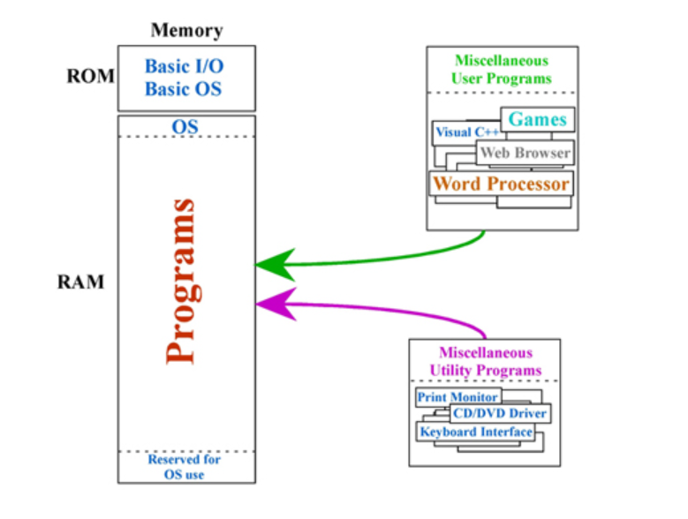
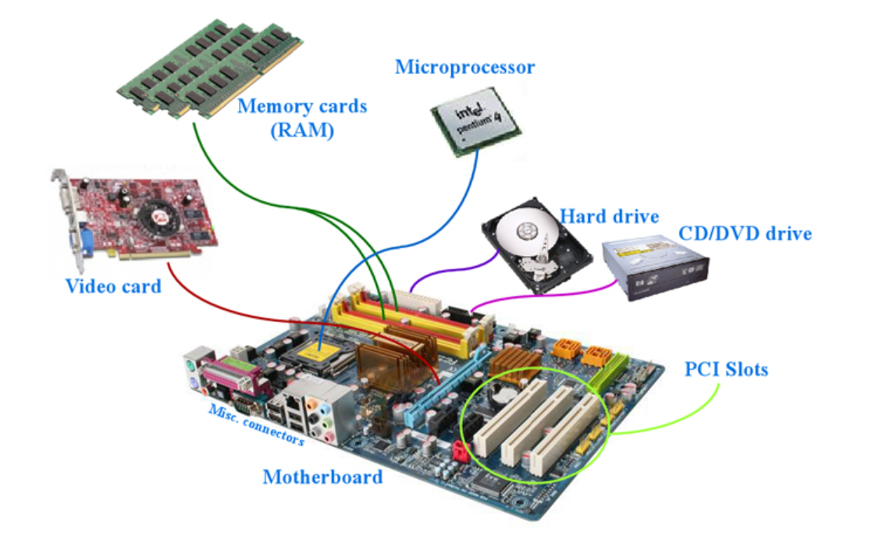

Slide 3
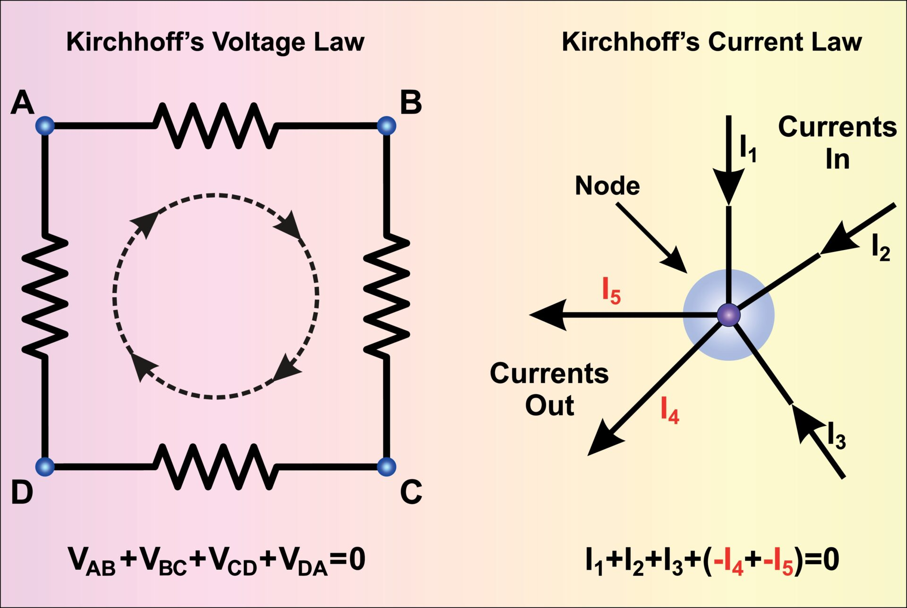
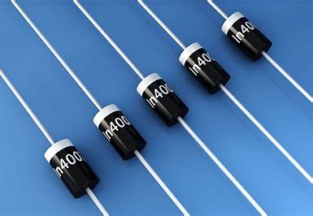
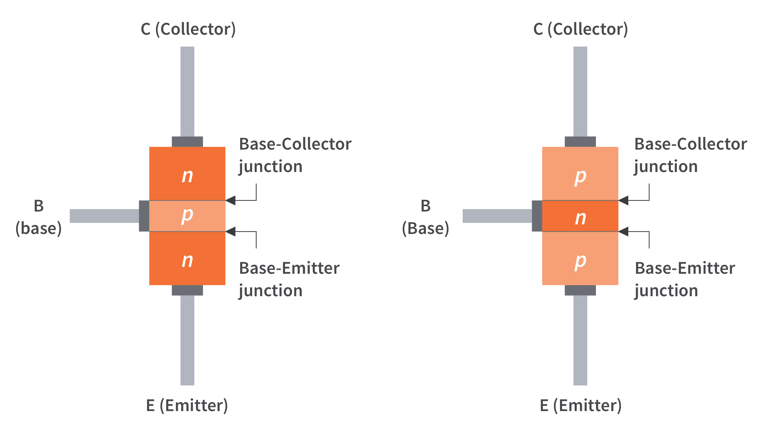
UNIT-1
Fundamentals of Electrical Laws, Semiconductor Devices, and its Applications

Slide 4
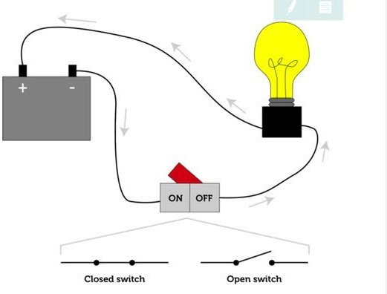
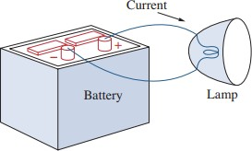
Electrical Circuit

Slide 5
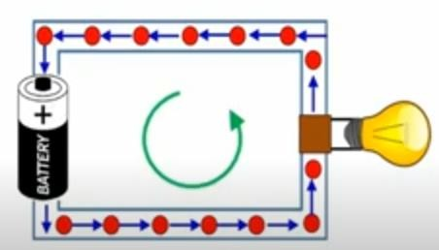












Charge and Current
Charge:
Charge is an electrical
property of the atomic particles of a matter.
S.I Unit: Coulomb (C)
Symbol: Q
Current: Rate of change of charge.
OR
Continuous flow electrons in an electrical circuit.
S.I Unit: Ampere (A) Symbol: I
of

Slide 6



Charge and Current
Mathematically,
𝑑𝑄
𝑡
𝑜𝑟 𝑄 = ∫ 𝐼. 𝑑𝑡
𝑡₀
𝐼 =
𝑑𝑡
Or, in simple terms:
𝑄
𝑇
𝐼 =
So, 1 Ampere = 1 coulomb/ 1 second.

Slide 7
QUICK QUIZ (Poll 1)
1 Coulomb is same as:
Watt /sec
Ampere/sec
Joule-sec
Ampere-sec

Slide 8
QUICK QUIZ (Poll 2)
The total charge entering the terminal is 5𝑠𝑖𝑛4𝜋𝑡 𝑚𝐶. Calculate current at t= 0.5 sec.:
A. 31.2 A
B. 31.2 mA
C. 62.8 mA
D. 62.8 A

Slide 9
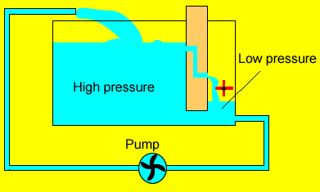
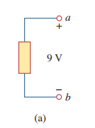







Voltage
It is the energy (Work) required to move a unit charge through a wire in closed path.
S.I Unit: Volt (V) Symbol: V

Slide 10
Power and Energy
Power: Rate at which the work is done.
OR
Time rate of absorbing or supplying energy
S.I Unit: Watts (W) Symbol: P
Mathematically,
𝑃 = ^{𝑑𝑊}=^{𝑑𝑊} . ^{𝑑𝑞} = 𝑉.𝐼
𝑑𝑡 𝑑𝑞 𝑑𝑡
Implies,
𝑃 = 𝑉. 𝐼

Slide 11
Power and Energy
Energy: Capacity of doing work.
S.I Unit: Joules(J) Symbol: E

Slide 12
QUICK QUIZ (Poll 3)
Calculate the current ratings of 100 Watt incandescent bulb and 15 Watt LED lamp operated with the domestic supply of 220 Volt?
Bulb = 0.068 A and LED = 0.45 A
Bulb = 0.45 A and LED = 0.068 A
Bulb =0.50 A and LED = 0.068 A
Bulb = 0.50 and LED = 0.68 A

Slide 13
QUICK QUIZ (Poll 4)
From the previous question, it can be inferred that:
LED consumes 5 times more current than Bulb.
Bulb consumes 5 times more current than LED..
LED consumes 6.6 times more current than Bulb.
Bulb consumes 6.6 times more current than LED.

Slide 14
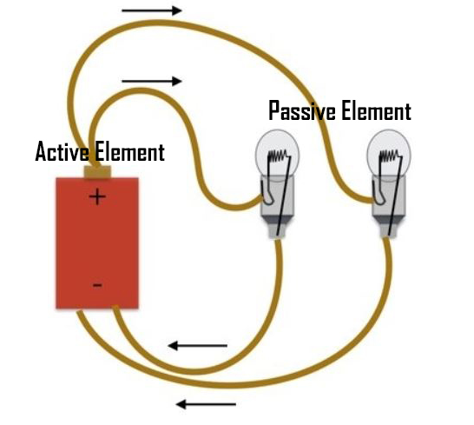
Network Components
Active
Passive
Battery
Resistance (R) Capacitance (C) Inductance (L)
Transformers
Transistor,
Op-amp,
Diode
VS and CS
Generators

Slide 15
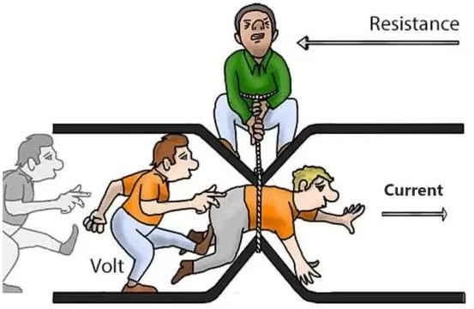

Resistance
Resistance: It is an opposition to the flow of current.
S.I Unit: Ohm (Ω)
Symbol: R

Slide 16
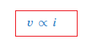
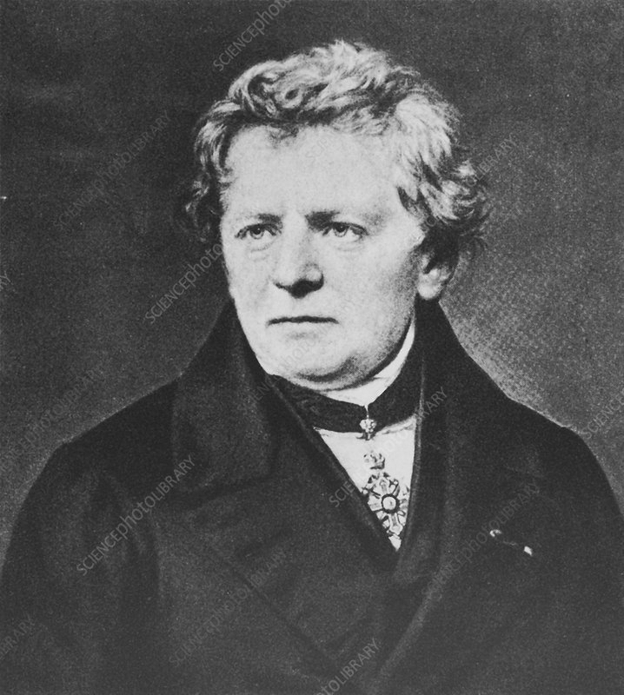
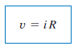
Ohm’s Law
Tool which is used for analysis of circuits: Ohm law, KVL and KCL
Given by Georg Simon Ohm (1787–1854), a German physicist
Ohm’s law states that the voltage v across a resistor is directly proportional to the current i flowing through the resistor.
Mathematically,

Slide 17







































Slide 18





























Slide 19
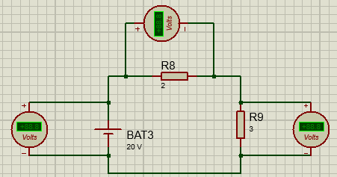
Electrical Circuit
Applications of Ohm’s Law
To find unknown Voltage (V)
To Find unknown Resistance (R)
To Find unknown Current (I)
Can be used to find Unknown Conductance (G)=1/R
Can be used to find unknown Power (P)=VI
Can be used to find unknown conductivity or Resistivity

Slide 20
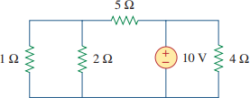
Limitations of Ohm’s Law
Ohm’s law holds true only for a conductor at a constant temperature. Resistivity changes with temperature.
Ohm’s law by itself is not sufficient to analyze circuits.
It is NOT applicable to non linear elements, For example, Diodes, Transistors, Thyristors, etc.
This law cannot be applied to unilateral networks.

Slide 21
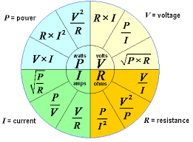
Applications of Ohm’s Law

Slide 22
Poll
Q.1 An electric iron draws 2 A at 120 V. Find its resistance.
Q.2 The essential component of a toaster is an electrical element (a resistor) that converts electrical energy to heat energy. How much current is drawn by a toaster with resistance 15 ohm at 110 V?
40 ohms, 2 Ampere
60 ohms, 7.33 Ampere
20 ohms 8 Ampere
100 ohms 10 Ampere

Slide 23
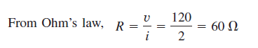
Solution:
Solution: I=V/R=110/15=7.333A

Slide 24
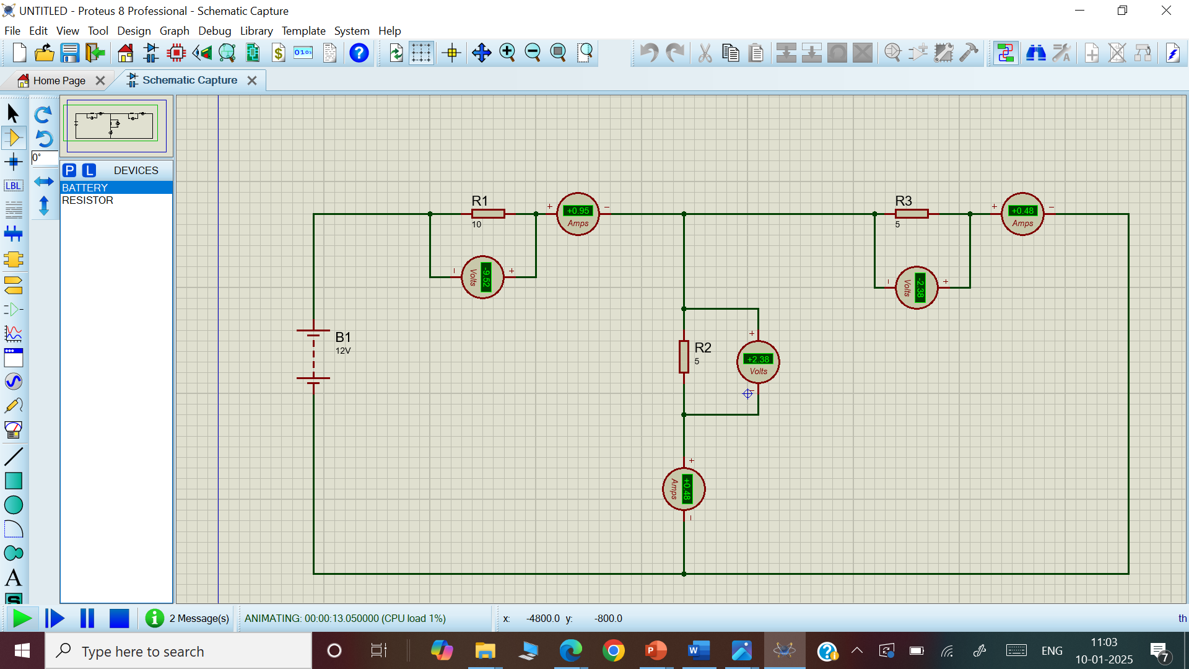

Slide 25
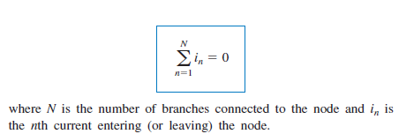
Kirchhoff’s Current Law (KCL)
Algebraic sum of currents entering a node (or a closed boundary) is zero.

Slide 26
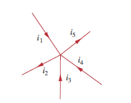
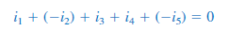
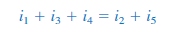
Sign Convention for KCL: Entering Current: Taken as +ve Leaving Current: Taken as -ve
The sum of the currents entering a node is equal to the sum of the currents leaving the node.

Slide 27
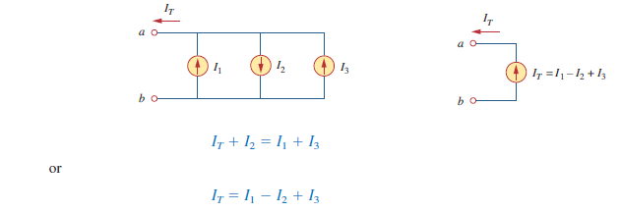
Example for KCL

Slide 28
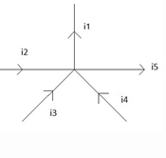
Poll
Q. Relation between currents according to KCL is
a) i₁=i₂=i₃=i₄=i₅ b) i₁+i₄+i₃=i₅+i₂ c) i₁-i₅=i₂-i₃-i₄ d) i₁+i₅=i₂+i₃+i₄

Slide 29
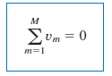
Kirchhoff’s Voltage Law (KVL)
Algebraic sum of all voltages around a closed path (or loop) is zero.
mathematically,

Slide 30
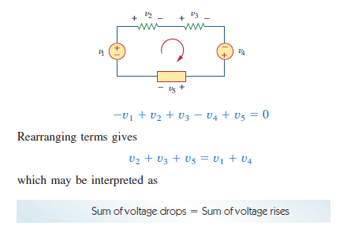
Example

Slide 31
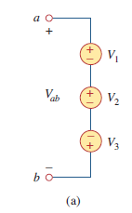
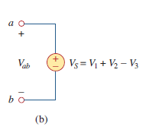
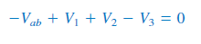
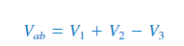
Example
Sum of voltage rises=Sum of voltage drops
Equivalent Circuit

Slide 32
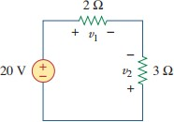
QUICK QUIZ (Poll 2)
Find voltages 𝑉₁ and 𝑉₂ in the given circuit:
A. 𝑉₁ = 16 𝑉 𝑎𝑛𝑑 𝑉₂ = 12 𝑉
B. 𝑉₁ = 16 𝑉 𝑎𝑛𝑑 𝑉₂ = −8 𝑉
C. 𝑉₁ = 8 𝑉 𝑎𝑛𝑑 𝑉₂ = −12 𝑉
D. 𝑉₁ = −12 𝑉 𝑎𝑛𝑑 𝑉₂ = 8 𝑉

Slide 33
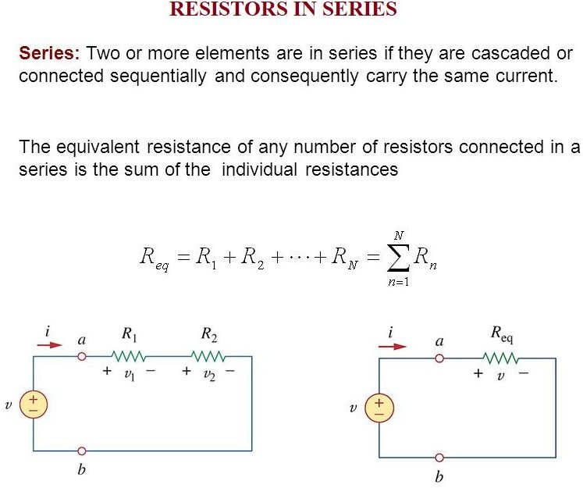
Note: Resistors in series behave as a single resistor whose resistance is equal to the sum of the resistances of the individual resistors.

Slide 34
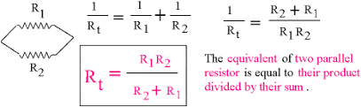
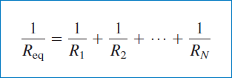
Resistors in Parallel
.

Slide 35
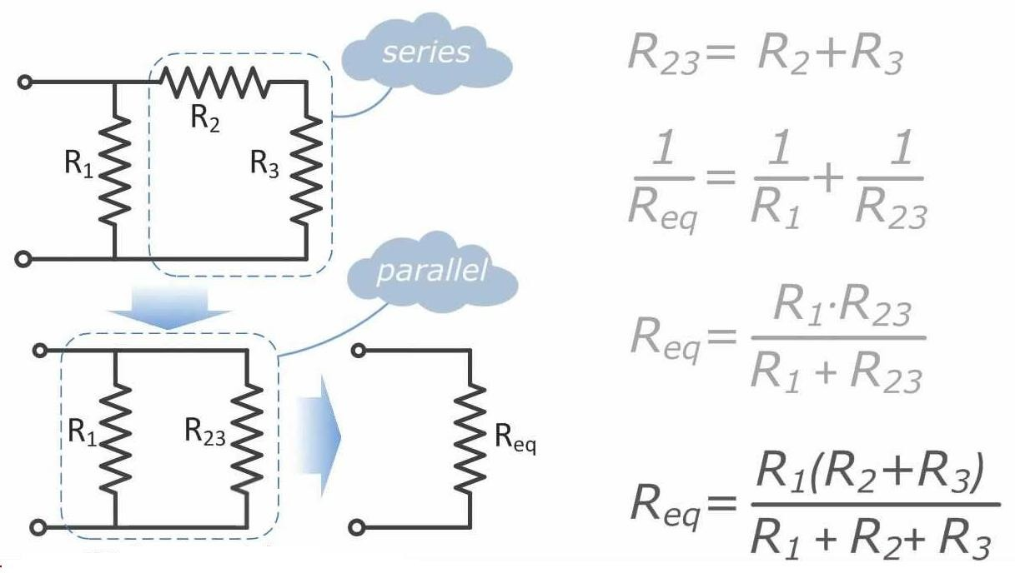
How to find Equivalent Resistance for Series-Parallel Combinations

Slide 37
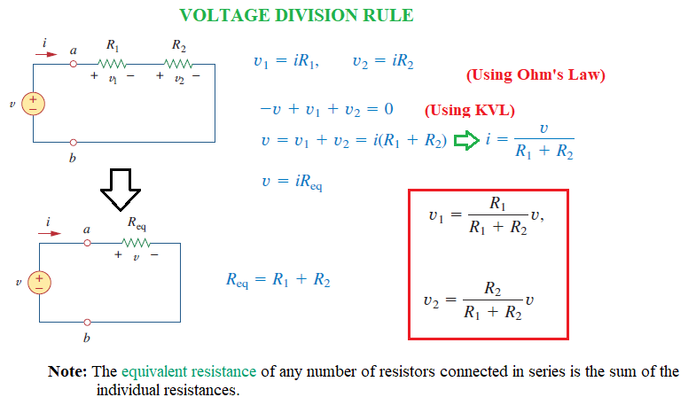

Slide 38
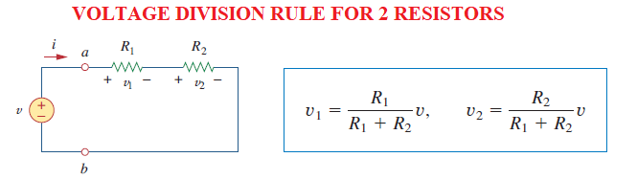
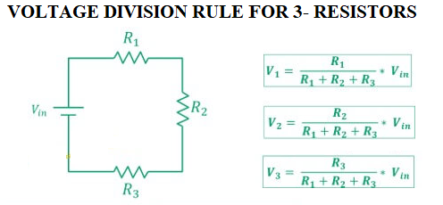
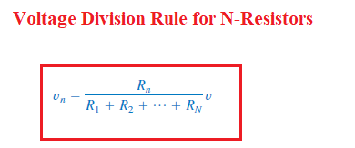
Note: This rule can be generalized for any number of resistors in series

Slide 39
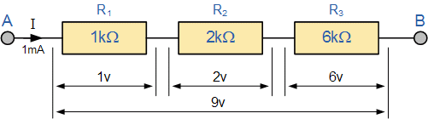
Example for Voltage Division Rule

Slide 40
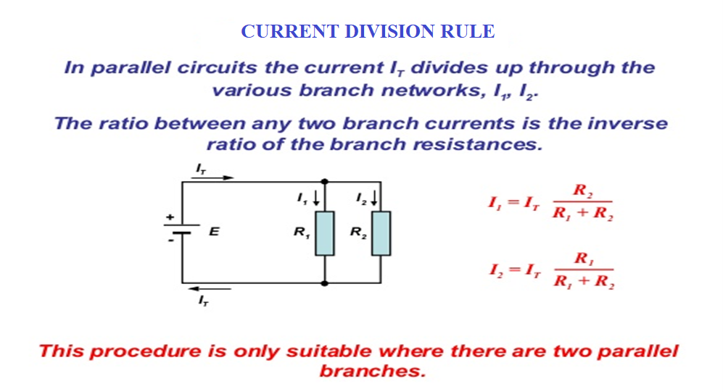

Slide 41
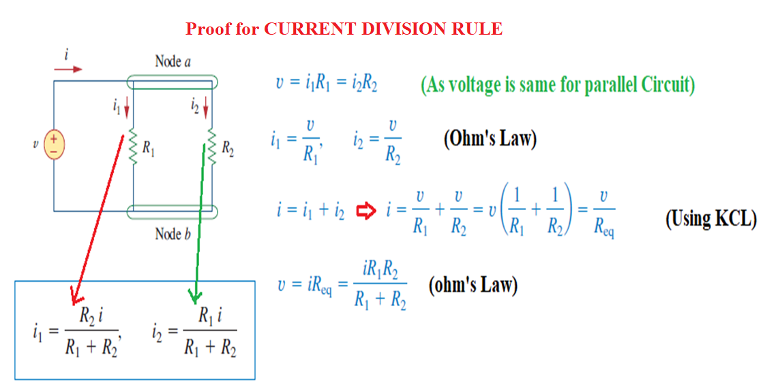

Slide 42
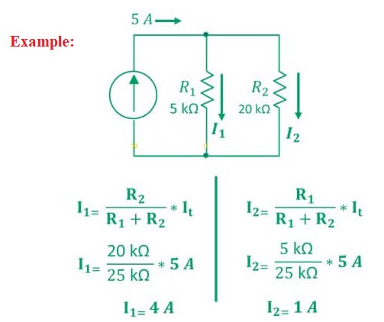

Slide 43
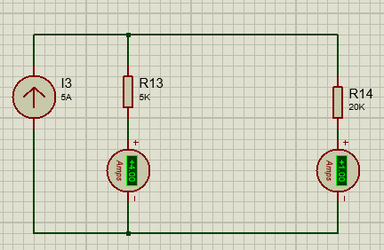
Simulation based Implementation

Slide 44
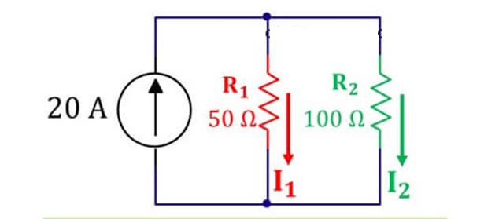
POLL
I1 = 13.33 A
I1 = 23.33 A
I1 = 6.666 A
I1 = 8.666 A

Slide 45
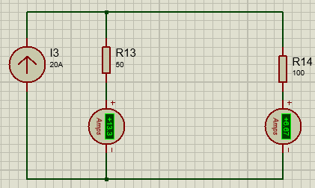
Simulation based Implementation

Slide 46
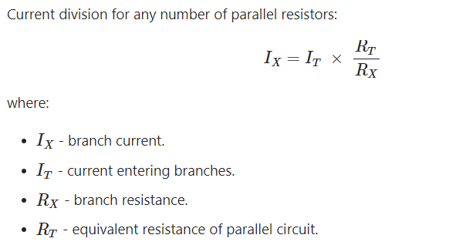
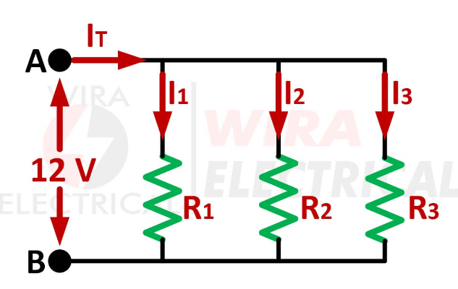

Slide 47


Slide 48

Simulation based Implementation

Slide 49
Applications of Kirchhoff’s Laws
They can be used to analyze any electrical circuit.
Computation of current and voltage of complex circuits.

Slide 50

Limitations of Kirchhoff’s Laws
The limitation of Kirchhoff’s both laws is that it works under the assumption that there is no fluctuating magnetic field in the closed loop and the current flows only through conductors and wires.

Slide 51


Nodes, Branches, and Loops
A branch represents a single element such as a voltage source or a resistor.
A node is the point of connection between
two or more branches.
A loop is any closed path in a circuit
NOTE:
Two or more elements are in series if they exclusively share a single node and consequently carry the same current.
Two or more elements are in parallel if they are connected to the same two nodes and consequently have the same voltage across them.

Slide 52
QUICK QUIZ (Poll 4)
How many branches, nodes and independent loops are present in the given circuit?
A. b=3, n=5, l=6
B. b=5, n=3, l=6
C. b=5, n=3, l=3
D. b=3, n=5, l=3

Slide 53
E-Resources
https://be-iitkgp.vlabs.ac.in/List%20of%20experiments.html

Slide 54


